Slide 1
Threads, IPC, Synchronization in Linux
Chapter 12
Beginning Linux Programming

Slide 2
THREADS
Chapter 12

Slide 3
Thread
All the program that we have written so far have had just one thread of execution
Time to do many tasks within a single program
We need many threads of execution in a single program
Writing multithreaded programs requires very careful design
In Linux we would use POSIX Threads, usually referred to as Pthreads.

Slide 4
Thread
The subroutines which comprise the Pthreads API can be informally grouped into
three major classes:
Thread management
Mutexes
Semaphores

Slide 5
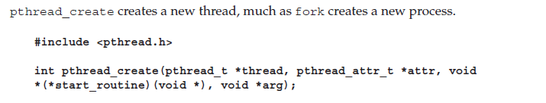


Threads

Slide 6
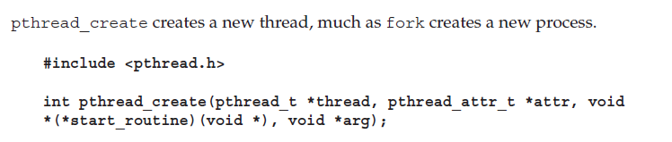
Thread Creation
Arguments
pointer to pthread object (used as thread identifier)
the thread attributes (NULL for us)
the address of a function taking a pointer to void as a parameter and the function will return a pointer to void
the thread would execute this
we can pass any type of single argument and return a pointer to any type (needs typecasting)
argument passed to this function
Returns 0 on success

Slide 7
Simple Example
#include<stdio.h>
#include<pthread.h>
#include<stdlib.h>
void * threadFunc1(void * arg){
int i;
for(i=1;i<=5;i++){
printf("%s\n",(char*)arg);
sleep(1);
}
}
int main(void){
pthread_t thread1;
pthread_t thread2;
char * message1 = “I am thread 1”;
char * message2 = “I am thread 2”;
pthread_create(&thread1,NULL,threadFunc1,(void*)message1 );
pthread_create(&thread2,NULL,threadFunc1,(void*)message2 );
while(1);
return 0;
}

Slide 8

Thread Exit
When a thread terminates, it calls the pthread_exit function
terminates the calling thread,
returns a pointer to an object

Slide 9

Thread Join
The first parameter is the thread for which to wait
the identifier that pthread_create filled in for us.
The second argument is a pointer to a pointer that itself points to the return value from the thread.

Slide 10
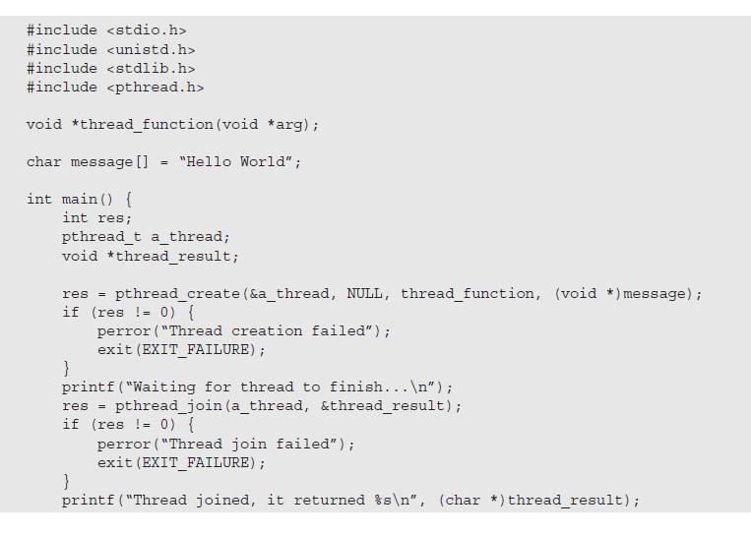
Thread Join

Slide 11
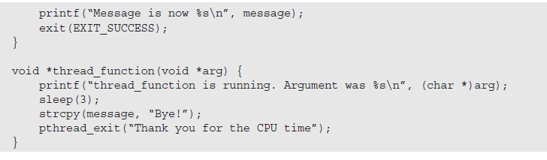
Thread Join

Slide 12
Requirements
we must define the macro _REENTRANT
include the file pthread.h, and
link with the threads library using –lpthread or -pthread
To compile & link a source file named thread
gcc -D_REENTRANT thread.c -o thread –lpthread
Run
./thread

Slide 13
Semaphores
Chapter 14

Slide 14

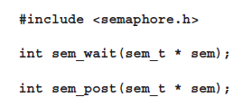

Semaphores in Thread

Slide 15
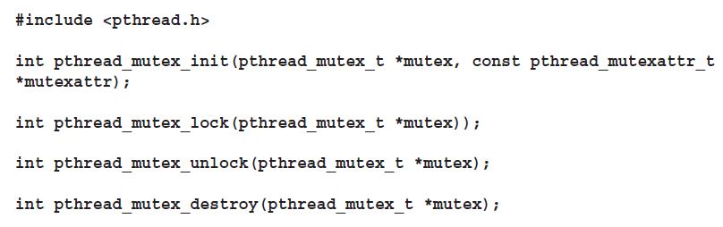
Mutex

